Slide 1
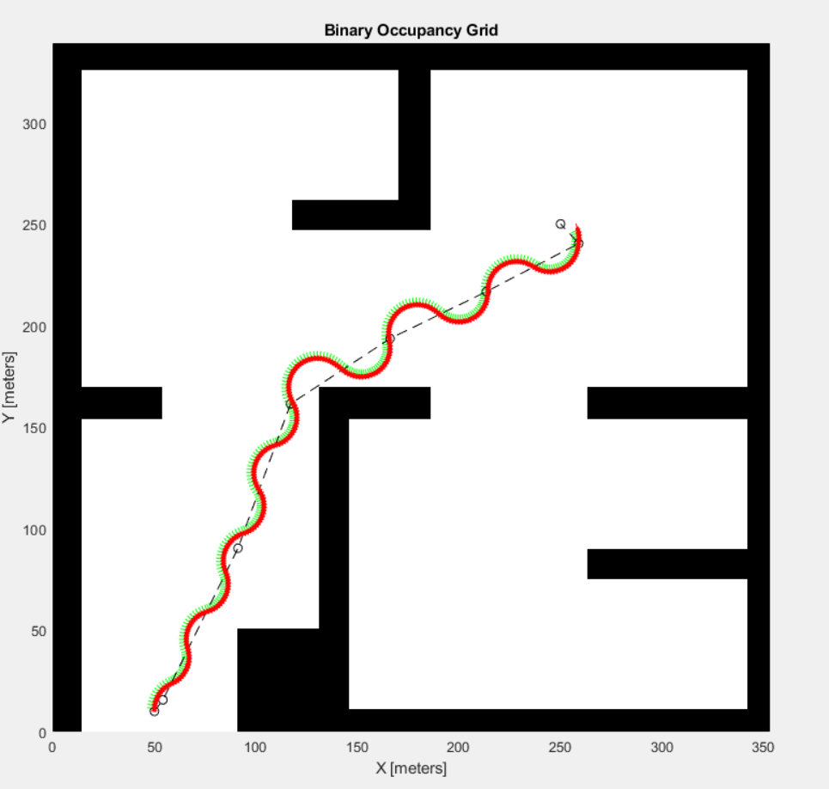
Single Robot with Probabilistic Roadmap Path Planner
Workflow:
Initial Position
2D-image of the map
Inflated
Binary Occupancy Map
PRM – Probabilistic Roadmap Path Planner
Pure Pursuit Controller
Differential Drive Kinematics
Goal Position
waypoints
v, ω
Pose
update
Result:
Pros:
The way points need not be decided manually, as compared to the existing system
Easy implementation – different paths with different controller parameters
Next Steps:
Extend the single robot environment, to a multi robot environment (swarm)
Investigate ways for swarm robot interaction to avoid robot-robot collisions
Find ways to integrate LIDAR for localisation and path planning
Investigate other kinds of controllers and kinematic models – more realistic w.r.t to an actual vehicle
Goal Position
Cons:
Obstacle free path decided by the PRM, and the robot follow the path with the help of a controller. But the robot itself has no obstacle detection capability
The parameters for pure pursuit controller are somewhat hard to tune – either result in oscillating motions of the bot, or fail to follow the obstacle-free path in some cases
High node, short distance maps are ideal but take long to set-up and find a path
Initial Position

